Slide 1
Deep Learning

Slide 2
Basic
List
list1 = [1, 2, 3] print(type(list1)) print(list1[0], list1[-1]) #인덱스가 음수일 경우 리스트의 끝에서부터 셈 list1[1] = “str1” print(list1) #리스트는 자료형이 다른 요소도 저장 가능 list2 = range(10) print(list2) print(type(list2)) #range Type출력 list2 = list(list2) #List Type으로 변환 print(type(list2)) print(list2[2:4]) # 인덱스 2에서 4(제외)까지 슬라이싱 print(list2[2:]) # 인덱스 2에서 끝까지 슬라이싱 print(list2[:2]) # 처음부터 인덱스 2(제외)까지 슬라이싱 print(list2[:]) # 전체 리스트 슬라이싱 print(list2[::2]) # 2씩 증가하면서 리스트 출력 print(list2[:-1]) # 슬라이싱 인덱스는 음수도 가능 list2[2:4] = [8, 9] # 슬라이스된 리스트에 새로운 리스트 할당 print(list2)

Slide 3
Basic
For Loop
animals = ['cat', 'dog', 'monkey'] for animal in animals: print(animal) nums = [0, 1, 2, 3, 4] squares = [] for x in nums: squares.append(x ** 2) print(squares)

Slide 4
Basic
Function (1)
def sign(x): if x > 0: return 'positive' elif x < 0: return 'negative' else: return 'zero' for x in [-1, 0, 1]: print(sign(x)) # 출력 "negative", "zero", "positive", 한 줄에 하나씩 출력.

Slide 5
Basic
Function (2)
def hello(name, loud=False): if loud: print ('HELLO, %s!' % name.upper()) else: print ('Hello, %s' % name) hello('Bob') # 출력 "Hello, Bob" hello('Fred', loud=True) # 출력 "HELLO, FRED!"

Slide 6
Numpy
Basic Code (1)
import numpy as np a = np.array([1, 2, 3]) # rank가 1인 배열 생성 print(type(a)) # 출력 "<type 'numpy.ndarray'>" print(a.shape) # 출력 "(3,)" print(a.ndim) # 출력 "1" print(a[0], a[1], a[2]) # 출력 "1 2 3" a[0] = 5 # 요소를 변경 print(a) # 출력 "[5, 2, 3]" b = np.array([[1,2,3],[4,5,6]]) # rank가 2인 배열 생성 print(b.shape) # 출력 "(2, 3)" print(b.ndim) # 출력 "2" print(b[0, 0], b[0, 1], b[1, 0]) # 출력 "1 2 4"

Slide 7
Numpy
Basic Code (2)
import numpy as np a = np.zeros((2,2)) # 모든 값이 0인 배열 생성 print(a) # 출력 "[[ 0. 0.] # [ 0. 0.]]" b = np.ones((1,2)) # 모든 값이 1인 배열 생성 print(b) # 출력 "[[ 1. 1.]]" c = np.full((2,2), 7) # 모든 값이 특정 상수인 배열 생성 print(c) # 출력 "[[ 7. 7.] # [ 7. 7.]]" d = np.eye(2) # 2x2 단위행렬 생성 print(d) # 출력 "[[ 1. 0.] # [ 0. 1.]]" e = np.random.random((2,2)) # 임의의 값으로 채워진 배열 생성 print(e) # 임의의 값 출력 "[[ 0.91940167 0.08143941] # [ 0.68744134 0.87236687]]"

Slide 8
Numpy
Basic Code (3)
import numpy as np # [[ 1 2 3 4] # [ 5 6 7 8] # [ 9 10 11 12]] a = np.array([[1,2,3,4], [5,6,7,8], [9,10,11,12]]) # 슬라이싱을 이용하여 첫 두 행과 1열, 2열로 이루어진 부분배열 생성; # b는 shape가 (2,2)인 배열이 됨: # [[2 3] # [6 7]] b = a[:2, 1:3] # 슬라이싱된 배열은 원본 배열과 같은 데이터를 참조, 즉 슬라이싱된 배열을 수정하면 # 원본 배열 역시 수정됨. print(a[0, 1]) # 출력 "2" b[0, 0] = 77 # b[0, 0]은 a[0, 1]과 같은 데이터 print(a[0, 1]) # 출력 "77"

Slide 9
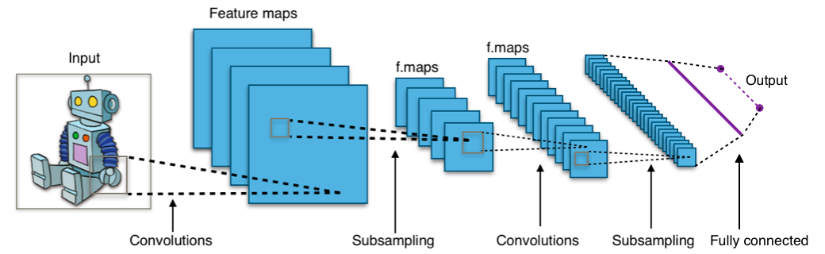
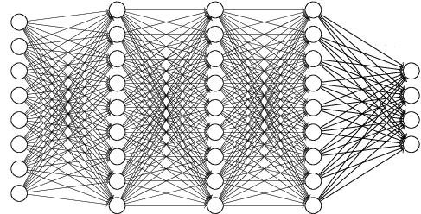
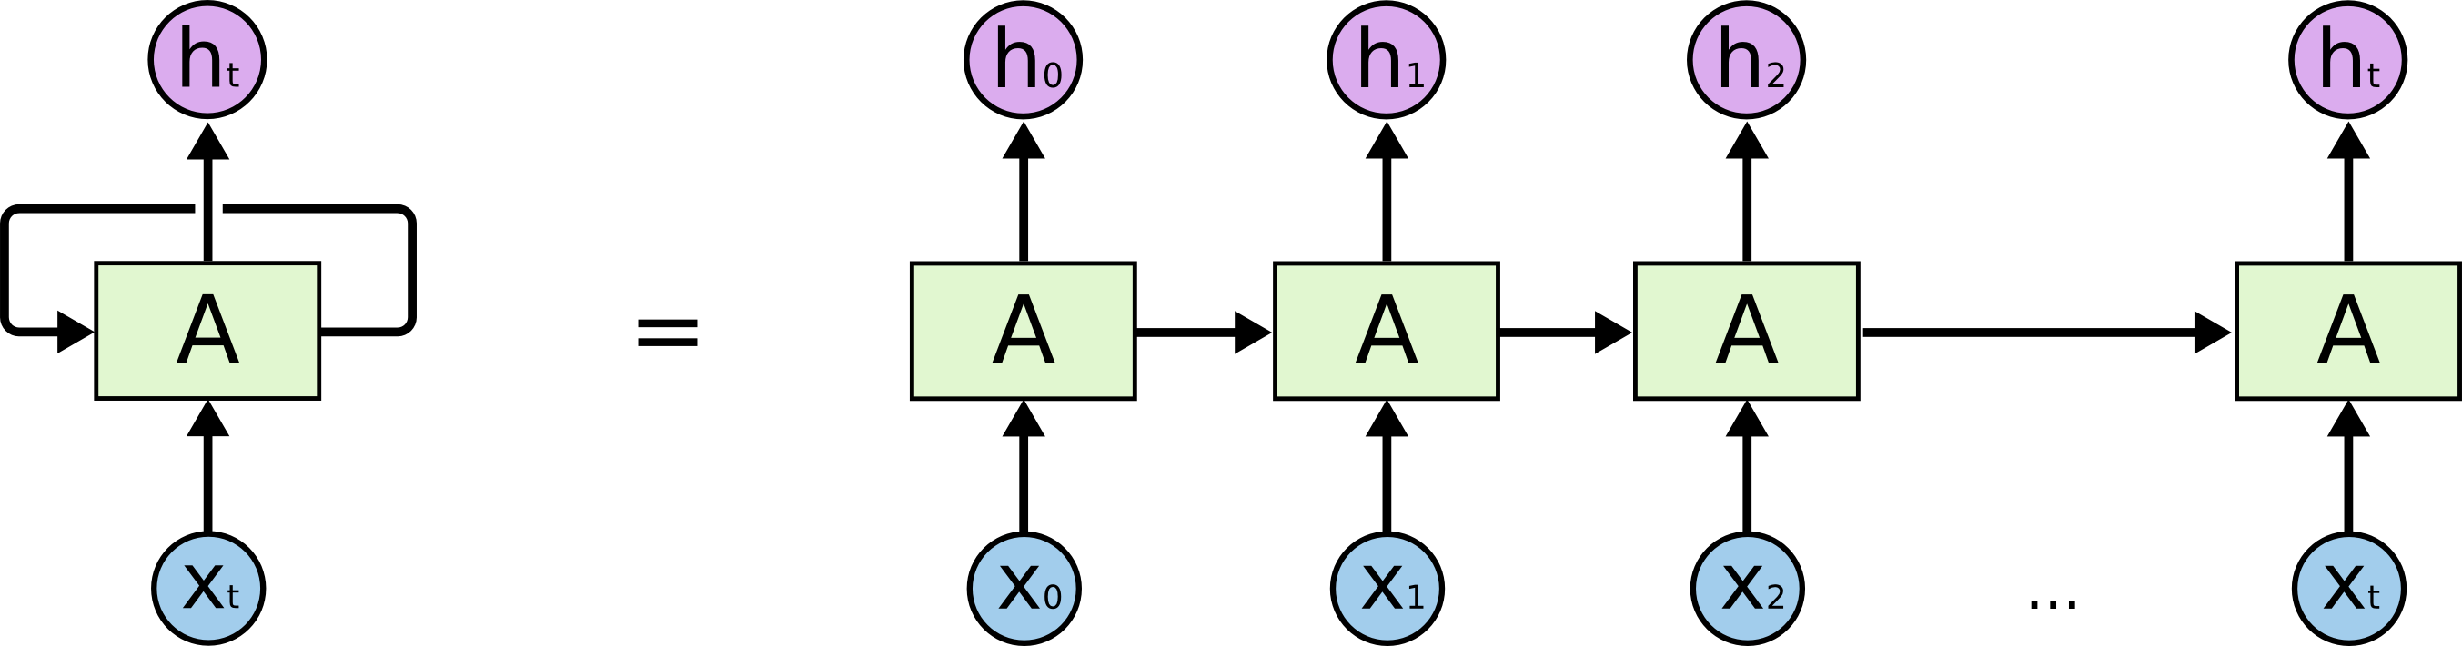
Deep Neural Network
Type of Deep Neural Network
Dense Network (=Fully-connected Neural Network)
Convolutional Neural Network
Recurrent Neural Network
…
<Convolutional Neural Network>
<Dense Network>
<Recurrent Neural Network>

Slide 10
Dense Network
What is the Dense Network?
Consists of multiple Dense layers
Input Layer
Hidden Layer 1
Hidden Layer 2
Hidden Layer 3
Output Layer

Slide 11
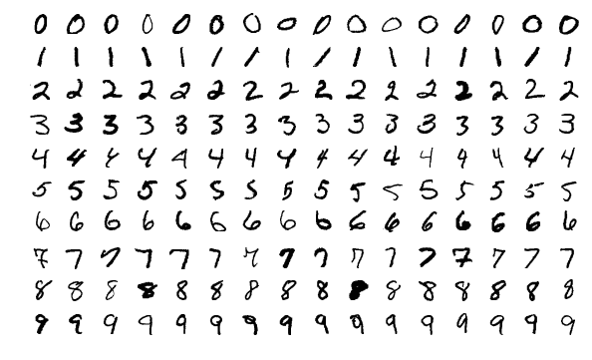
3-layer DN for MNIST
MNIST Dataset
Large data of handwritten digits that is commonly used for training various image processing systems and machine learning
It contains 60,000 training images and 10,000 testing images (28 X 28 pixel)
<Sample images from MNIST test dataset>

Slide 12
3-layer DN for MNIST
Model Overview
.
.
.
.
.
.
.
.
.
Bias
+1
+1
Input Layer
(28*28=784)
Hidden Layer
(256)
Output Layer
(10)

Slide 13
3-layer DN for MNIST
Preparation
MNIST dataset download and load to mnist variable with one_hot label encoding
For example)
0 => <1, 0, 0, 0, 0, 0, 0, 0, 0, 0>
1 => <0, 1, 0, 0, 0, 0, 0, 0, 0, 0>
…
9 => <0, 0, 0, 0, 0, 0, 0, 0, 0, 10>
55,000 grayscale training and 10,000 grayscale test image
import tensorflow as tf from tensorflow.examples.tutorials.mnist import input_data mnist = input_data.read_data_sets("./mnist/data/", one_hot=True)

Slide 14
3-layer DN for MNIST
Setup Placeholders for Data and Label
A image consists of 784 pixels (28X28)
A label consists of 10 classes (0 – 9)
First dimension (None) will index the images in the mini-batch
X = tf.placeholder(tf.float32, [None, 784]) Y = tf.placeholder(tf.float32, [None, 10])

Slide 15
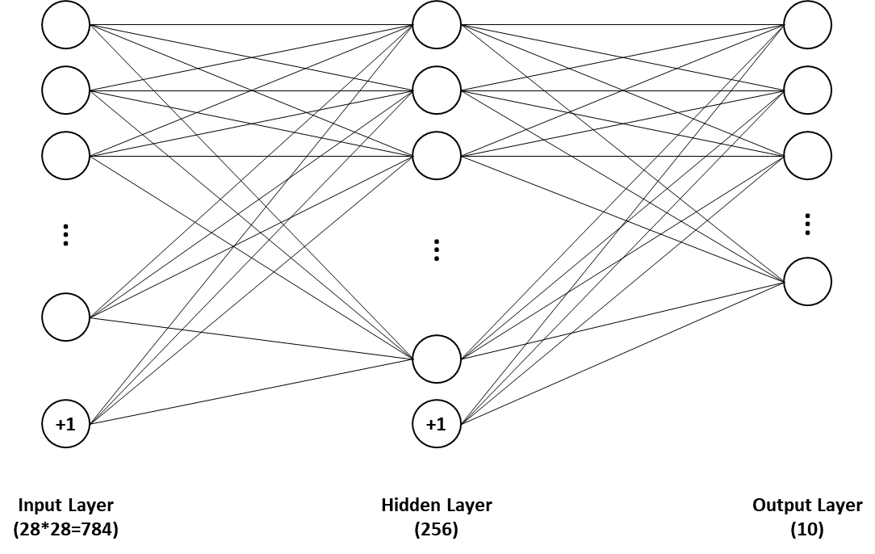
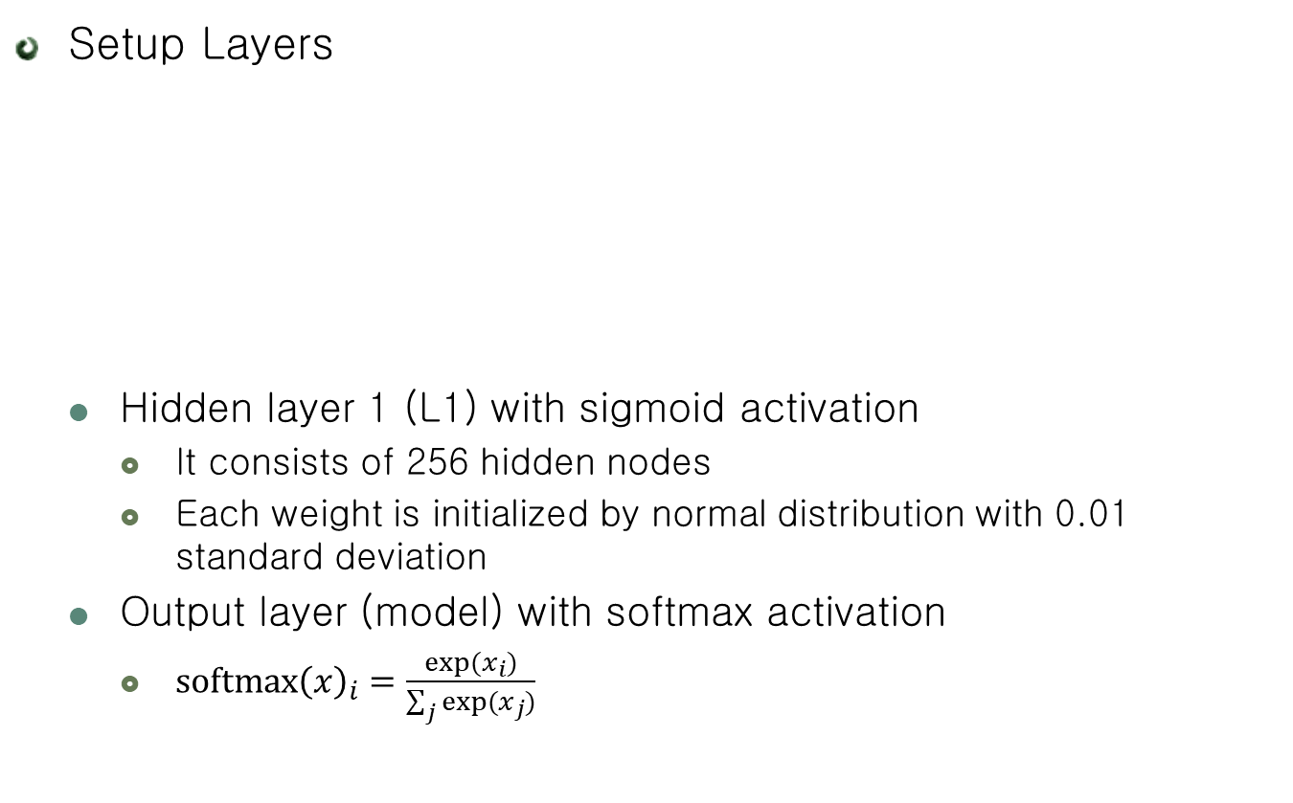
3-layer DN for MNIST
Setup Layers
Hidden layer 1 (L1) with sigmoid activation
It consists of 256 hidden nodes
Each weight is initialized by normal distribution with 0.01 standard deviation
Output layer (model) with softmax activation
$softmax{\left(x\right)}_{i}=\frac{exp⁡(x_{i})}{\sum_{j}{exp⁡(x_{j})}}$
W1 = tf.Variable(tf.random_normal([784, 256], stddev=0.01))
B1 = tf.Variable(tf.random_normal(shape=[256], stddev=0.01))
L1 = tf.nn.sigmoid(tf.matmul(X, W1)+B1)
W2 = tf.Variable(tf.random_normal([256, 10], stddev=0.01))
B2 = tf.Variable(tf.random_normal(shape=[10], stddev=0.01))
model = tf.nn.softmax(tf.matmul(L1, W2)+B2)

Slide 16
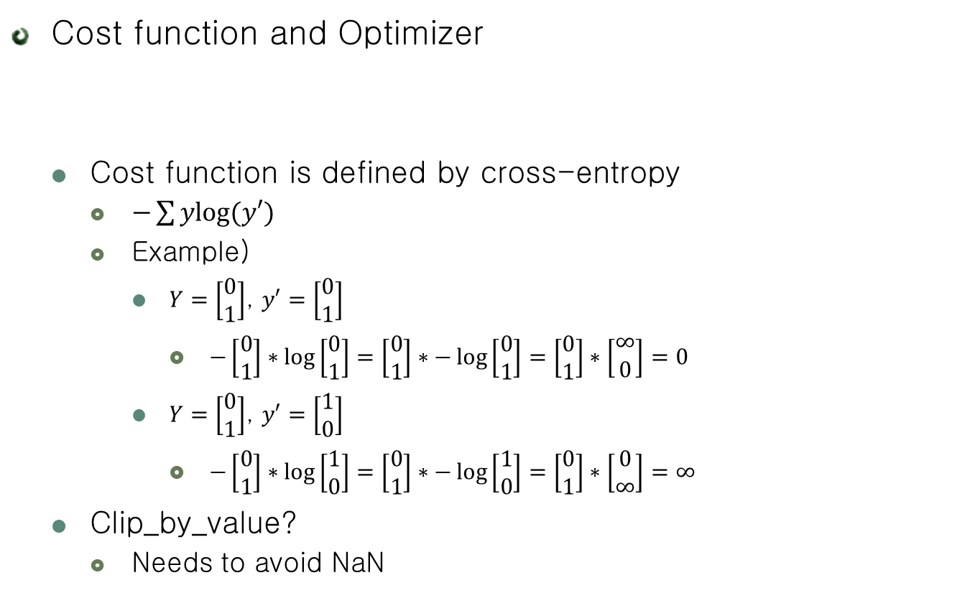
3-layer DN for MNIST
Cost function and Optimizer
Cost function is defined by cross-entropy
$−\sum{ylog⁡(y′)}$
Example)
$Y=\left[\begin{matrix}0 \\ 1\end{matrix}\right]$, $y′=\left[\begin{matrix}0 \\ 1\end{matrix}\right]$
$−\left[\begin{matrix}0 \\ 1\end{matrix}\right]∗\log\left[\begin{matrix}0 \\ 1\end{matrix}\right]=\left[\begin{matrix}0 \\ 1\end{matrix}\right]∗−\log\left[\begin{matrix}0 \\ 1\end{matrix}\right]=\left[\begin{matrix}0 \\ 1\end{matrix}\right]∗\left[\begin{matrix}∞ \\ 0\end{matrix}\right]=0$
$Y=\left[\begin{matrix}0 \\ 1\end{matrix}\right]$, $y′=\left[\begin{matrix}1 \\ 0\end{matrix}\right]$
$−\left[\begin{matrix}0 \\ 1\end{matrix}\right]∗\log\left[\begin{matrix}1 \\ 0\end{matrix}\right]=\left[\begin{matrix}0 \\ 1\end{matrix}\right]∗−\log\left[\begin{matrix}1 \\ 0\end{matrix}\right]=\left[\begin{matrix}0 \\ 1\end{matrix}\right]∗\left[\begin{matrix}0 \\ ∞\end{matrix}\right]=∞$
Clip_by_value?
Needs to avoid NaN
cost = tf.reduce_mean(-tf.reduce_sum(Y * tf.log(tf.clip_by_value(model, 1e-10,1.0)), [1]))
optimizer = tf.train.AdamOptimizer(0.001).minimize(cost)

Slide 17
3-layer DN for MNIST
Cost function and Optimizer
Create an operation to initialize the variables
Launch the model in a Session
init = tf.global_variables_initializer() sess = tf.Session() sess.run(init)

Slide 18
3-layer DN for MNIST
Setup for mini-batch
Mini-batch
Weight update by using subset’s loss
Reduces the variance of the gradient
Avoids large memory usage
batch_size = 100 total_batch = int(mnist.train.num_examples / batch_size)

Slide 19

3-layer DN for MNIST
Setup for Accuracy
is_correct
Are they equal between model and Y
For example
$model=\left[0, 0, 0, 1\right], Y=[0, 0, 0, 1]$
$eq\left(3, 3\right)=True$
$model=\left[0, 0, 0, 1\right], Y=[0, 0, 1, 0]$
$eq\left(3, 2\right)=False$
is_correct = tf.equal(tf.argmax(model, 1), tf.argmax(Y, 1)) accuracy = tf.reduce_mean(tf.cast(is_correct, tf.float32))

Slide 20
3-layer DN for MNIST
Training!
Model update by using mini-batch
Total epoch is 15
for epoch in range(15): total_cost = 0 for i in range(total_batch): batch_xs, batch_ys = mnist.train.next_batch(batch_size) _, cost_val = sess.run([optimizer, cost], feed_dict={X: batch_xs, Y: batch_ys}) total_cost += cost_val print('Epoch:', '%04d' % (epoch + 1), 'Avg. cost =', '{:.3f}'.format(total_cost / total_batch), 'Train Acc. =', sess.run(accuracy, feed_dict={X: mnist.train.images, Y: mnist.train.labels}))

Slide 21
3-layer DN for MNIST
Evaluation for Test Dataset
print('Training Done!') print('Test Acc. = ', sess.run(accuracy, feed_dict={X: mnist.test.images, Y: mnist.test.labels}))

Slide 22
3-layer DN for MNIST
Run!
Epoch: 0001 Avg. cost = 0.602 Train Acc. = 0.921564
Epoch: 0002 Avg. cost = 0.237 Train Acc. = 0.942364
Epoch: 0003 Avg. cost = 0.183 Train Acc. = 0.956073
Epoch: 0004 Avg. cost = 0.149 Train Acc. = 0.962818
Epoch: 0005 Avg. cost = 0.124 Train Acc. = 0.970236
Epoch: 0006 Avg. cost = 0.104 Train Acc. = 0.974636
Epoch: 0007 Avg. cost = 0.089 Train Acc. = 0.978891
Epoch: 0008 Avg. cost = 0.076 Train Acc. = 0.982455
Epoch: 0009 Avg. cost = 0.066 Train Acc. = 0.9858
Epoch: 0010 Avg. cost = 0.057 Train Acc. = 0.987036
Epoch: 0011 Avg. cost = 0.049 Train Acc. = 0.989909
Epoch: 0012 Avg. cost = 0.043 Train Acc. = 0.991382
Epoch: 0013 Avg. cost = 0.037 Train Acc. = 0.992018
Epoch: 0014 Avg. cost = 0.032 Train Acc. = 0.994618
Epoch: 0015 Avg. cost = 0.027 Train Acc. = 0.995582
Training Done!
Test Acc. = 0.9784

Slide 23
3-layer DN for MNIST
Code (1)
import tensorflow as tf from tensorflow.examples.tutorials.mnist import input_data mnist = input_data.read_data_sets("./mnist/data/", one_hot=True) X = tf.placeholder(tf.float32, [None, 784]) Y = tf.placeholder(tf.float32, [None, 10]) W1 = tf.Variable(tf.random_normal([784, 256], stddev=0.01)) B1 = tf.Variable(tf.random_normal(shape=[256], stddev=0.01)) L1 = tf.nn.sigmoid(tf.matmul(X, W1) + B1) W2 = tf.Variable(tf.random_normal([256, 10], stddev=0.01)) B2 = tf.Variable(tf.random_normal(shape=[10], stddev=0.01)) model = tf.nn.softmax(tf.matmul(L1, W2) + B2) cost = tf.reduce_mean(-tf.reduce_sum(Y * tf.log(tf.clip_by_value(model, 1e-10, 1.0)), [1])) optimizer = tf.train.AdamOptimizer(0.001).minimize(cost)
init = tf.global_variables_initializer() sess = tf.Session() sess.run(init)

Slide 24
3-layer DN for MNIST
Code (2)
batch_size = 100 total_batch = int(mnist.train.num_examples / batch_size) is_correct = tf.equal(tf.argmax(model, 1), tf.argmax(Y, 1)) accuracy = tf.reduce_mean(tf.cast(is_correct, tf.float32)) for epoch in range(15): total_cost = 0 for i in range(total_batch): batch_xs, batch_ys = mnist.train.next_batch(batch_size) _, cost_val = sess.run([optimizer, cost], feed_dict={X: batch_xs, Y: batch_ys}) total_cost += cost_val print('Epoch:', '%04d' % (epoch + 1), 'Avg. cost =', '{:.3f}'.format(total_cost / total_batch), 'Train Acc. =', sess.run(accuracy, feed_dict={X: mnist.train.images, Y: mnist.train.labels})) print('Training Done!') print('Test Acc. = ', sess.run(accuracy, feed_dict={X: mnist.test.images, Y: mnist.test.labels}))

Slide 25
Practice: 5-layer DN for MNIST
Model Overview
Input Layer
(784)
Hidden Layer 1
(1024)
Hidden Layer 2
(512)
Hidden Layer 3
(256)
Output Layer
(10)

Slide 26
Practice: 5-layer DN for MNIST
Code
We change only layers
W1 = tf.Variable(tf.random_normal([784, 1024], stddev=0.01)) B1 = tf.Variable(tf.random_normal(shape=[1024], stddev=0.01)) L1 = tf.nn.sigmoid(tf.matmul(X, W1) + B1) W2 = tf.Variable(tf.random_normal([1024, 512], stddev=0.01)) B2 = tf.Variable(tf.random_normal(shape=[512], stddev=0.01)) L2 = tf.nn. sigmoid(tf.matmul(L1, W2) + B2) W3 = tf.Variable(tf.random_normal([512, 256], stddev=0.01)) B3 = tf.Variable(tf.random_normal(shape=[256], stddev=0.01)) L3 = tf.nn. sigmoid(tf.matmul(L2, W3) + B3) W4 = tf.Variable(tf.random_normal([256, 10], stddev=0.01)) B4 = tf.Variable(tf.random_normal(shape=[10], stddev=0.01)) model = tf.nn.softmax(tf.matmul(L3, W4) + B4)

Slide 27
Practice: 5-layer DN for MNIST
Run!
Model | 3-layer
Acc. | 0.9784
Epoch: 0001 Avg. cost = 0.875 Train Acc. = 0.918364
Epoch: 0002 Avg. cost = 0.217 Train Acc. = 0.956127
Epoch: 0003 Avg. cost = 0.144 Train Acc. = 0.964691
Epoch: 0004 Avg. cost = 0.114 Train Acc. = 0.964873
Epoch: 0005 Avg. cost = 0.091 Train Acc. = 0.978255
Epoch: 0006 Avg. cost = 0.072 Train Acc. = 0.979091
Epoch: 0007 Avg. cost = 0.059 Train Acc. = 0.987491
Epoch: 0008 Avg. cost = 0.049 Train Acc. = 0.986509
Epoch: 0009 Avg. cost = 0.040 Train Acc. = 0.986127
Epoch: 0010 Avg. cost = 0.033 Train Acc. = 0.991836
Epoch: 0011 Avg. cost = 0.029 Train Acc. = 0.994745
Epoch: 0012 Avg. cost = 0.022 Train Acc. = 0.994491
Epoch: 0013 Avg. cost = 0.023 Train Acc. = 0.994909
Epoch: 0014 Avg. cost = 0.018 Train Acc. = 0.996782
Epoch: 0015 Avg. cost = 0.015 Train Acc. = 0.997509
Training Done!
Test Acc. = 0.9805

Slide 28
Extreme Case! (10-layer DN)
Model Overview
…
Input Layer
(784)
Hidden Layer 1
(1024)
Hidden Layer 2
(512)
Hidden Layer 4
(256)
Hidden Layer 6
(256)
Hidden Layer 8
(256)
Output Layer
(10)
Hidden Layer 3
(256)
Hidden Layer 5
(256)
Hidden Layer 7
(256)
Hidden Layer 9
(256)

Slide 29
Extreme Case! (10-layer DN)
Run!
Model | 3-layer | 5-layer
Acc. | 0.9784 | 0.9805
Epoch: 0001 Avg. cost = 2.303 Train Acc. = 0.112345
Epoch: 0002 Avg. cost = 2.301 Train Acc. = 0.112345
Epoch: 0003 Avg. cost = 2.301 Train Acc. = 0.112345
Epoch: 0004 Avg. cost = 2.301 Train Acc. = 0.112345
Epoch: 0005 Avg. cost = 2.301 Train Acc. = 0.112345
Epoch: 0006 Avg. cost = 2.301 Train Acc. = 0.112345
Epoch: 0007 Avg. cost = 2.301 Train Acc. = 0.112345
Epoch: 0008 Avg. cost = 2.301 Train Acc. = 0.112345
Epoch: 0009 Avg. cost = 2.301 Train Acc. = 0.112345
Epoch: 0010 Avg. cost = 2.301 Train Acc. = 0.112345
Epoch: 0011 Avg. cost = 2.301 Train Acc. = 0.112345
Epoch: 0012 Avg. cost = 2.301 Train Acc. = 0.112345
Epoch: 0013 Avg. cost = 2.301 Train Acc. = 0.112345
Epoch: 0014 Avg. cost = 2.301 Train Acc. = 0.112345
Epoch: 0015 Avg. cost = 2.301 Train Acc. = 0.112345
Training Done!
Test Acc. = 0.1135
Model is not trained!!

Slide 30
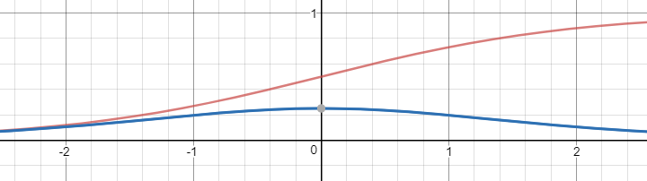

Extreme Case! (10-layer DN)
Why?
Vanishing Gradient Problem
Sigmoid
$sigmoid\left(x\right)=\frac{1}{1+e^{−x}}$
Derivate of sigmoid
$\frac{dsigmoid(x)}{dx}=\frac{1}{1+e^{−x}}×(1−\frac{1}{1+e^{−x}})$

Slide 31
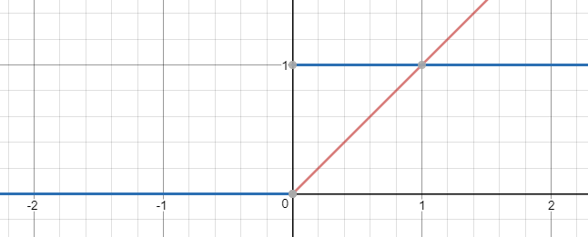

ReLU
Rectified Linear Unit
$f\left(x\right)=max⁡(0, x)$
Robust vanishing gradient!

Slide 32
ReLU
Modify the model structure
…
L1 = tf.nn.relu(tf.matmul(X, W1) + B1) …
L2 = tf.nn.relu(tf.matmul(L1, W2) + B2) …
L3 = tf.nn.relu(tf.matmul(L1, W2) + B2) …

Slide 33
ReLU
Run!
Model | 3-layer | 5-layer
Acc. | 0.9784 | 0.9805
Epoch: 0001 Avg. cost = 0.360 Train Acc. = 0.961782
Epoch: 0002 Avg. cost = 0.114 Train Acc. = 0.979455
Epoch: 0003 Avg. cost = 0.074 Train Acc. = 0.984382
Epoch: 0004 Avg. cost = 0.054 Train Acc. = 0.990255
Epoch: 0005 Avg. cost = 0.042 Train Acc. = 0.990182
Epoch: 0006 Avg. cost = 0.035 Train Acc. = 0.992982
Epoch: 0007 Avg. cost = 0.027 Train Acc. = 0.995073
Epoch: 0008 Avg. cost = 0.023 Train Acc. = 0.993309
Epoch: 0009 Avg. cost = 0.022 Train Acc. = 0.994255
Epoch: 0010 Avg. cost = 0.019 Train Acc. = 0.994236
Epoch: 0011 Avg. cost = 0.019 Train Acc. = 0.995655
Epoch: 0012 Avg. cost = 0.018 Train Acc. = 0.9956
Epoch: 0013 Avg. cost = 0.011 Train Acc. = 0.994655
Epoch: 0014 Avg. cost = 0.012 Train Acc. = 0.995836
Epoch: 0015 Avg. cost = 0.015 Train Acc. = 0.997255
Training Done!
Test Acc. = 0.9827

Slide 34
ReLU with Extreme Case
Run!
Model | 10-layer sigmoid
Acc. | 0.1135
Epoch: 0001 Avg. cost = 1.320 Train Acc. = 0.8922
Epoch: 0002 Avg. cost = 0.250 Train Acc. = 0.951127
Epoch: 0003 Avg. cost = 0.168 Train Acc. = 0.970418
Epoch: 0004 Avg. cost = 0.124 Train Acc. = 0.977018
Epoch: 0005 Avg. cost = 0.099 Train Acc. = 0.980218
Epoch: 0006 Avg. cost = 0.075 Train Acc. = 0.983345
Epoch: 0007 Avg. cost = 0.071 Train Acc. = 0.986982
Epoch: 0008 Avg. cost = 0.051 Train Acc. = 0.989491
Epoch: 0009 Avg. cost = 0.047 Train Acc. = 0.991364
Epoch: 0010 Avg. cost = 0.045 Train Acc. = 0.986855
Epoch: 0011 Avg. cost = 0.040 Train Acc. = 0.990091
Epoch: 0012 Avg. cost = 0.041 Train Acc. = 0.994509
Epoch: 0013 Avg. cost = 0.030 Train Acc. = 0.992491
Epoch: 0014 Avg. cost = 0.030 Train Acc. = 0.994436
Epoch: 0015 Avg. cost = 0.023 Train Acc. = 0.996073
Training Done!
Test Acc. = 0.9816

Slide 35
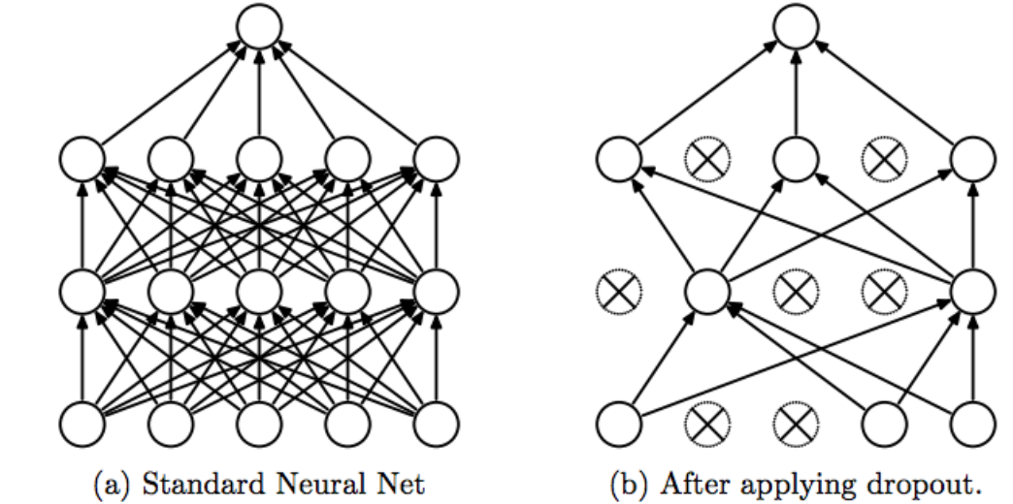
Dropout
Regularization technique for reducing overfitting

Slide 36
Dropout
How to make the Dropout
def dropout(x, keep_prob): mask = tf.floor(keep_prob * tf.ones(tf.shape(x)) + tf.random_uniform(shape=tf.shape(x))) return tf.divide(x, keep_prob) * mask
 | Operation | Values
A | keep_prob | 0.5
B | x | 0.3 | 0.7 | 1.5 | 0.2 | 0.9 | 1.3
C | keep_prob * tf.ones(tf.shape(x)) | 0.5 | 0.5 | 0.5 | 0.5 | 0.5 | 0.5
D | tf.random_uniform(shape=tf.shape(x)) | 0.1 | 0.9 | 0.7 | 0.3 | 0.5 | 0.2
E | C+D | 0.6 | 1.4 | 1.2 | 0.8 | 1.0 | 0.7
F | tf.math.floor(E) | 0 | 1 | 1 | 0 | 1 | 0
G | tf.divide(x, keep_prob) | 0.6 | 1.4 | 3.0 | 0.4 | 1.8 | 2.6
H | G * F | 0 | 1.4 | 3.0 | 0 | 1.8 | 0

Slide 37
Dropout
Modify the model structure
“keep_prob” is a placeholder for probability to keep
keep_prob = tf.placeholder(tf.float32) …
L1 = tf.nn.relu(tf.matmul(X, W1) + B1) L1 = tf.nn.dropout(L1, keep_prob) …
L2 = tf.nn.relu(tf.matmul(L1, W2) + B2) L2 = tf.nn.dropout(L2, keep_prob) …
L3 = tf.nn.dropout(L3, keep_prob)

Slide 38
Dropout
Feed the keep_prob
Feeding the “keep_prob” when only training
...
_, cost_val = sess.run([optimizer, cost], feed_dict={X: batch_xs, Y: batch_ys, keep_prob: 0.5}) total_cost += cost_val print('Epoch:', '%04d' % (epoch + 1), 'Avg. cost =', '{:.3f}'.format(total_cost / total_batch), 'Train Acc. =', sess.run(accuracy, feed_dict={X: mnist.train.images, Y: mnist.train.labels, keep_prob: 1.0})) print('Training Done!') print('Test Acc. = ', sess.run(accuracy, feed_dict={X: mnist.test.images, Y: mnist.test.labels, keep_prob: 1.0}))

Slide 39
Dropout
Model | 3-layer | 5-layer | 5-Layer ReLU
Acc. | 0.9784 | 0.9805 | 0.9827
Run!
Epoch: 0001 Avg. cost = 0.779 Train Acc. = 0.914891
Epoch: 0002 Avg. cost = 0.253 Train Acc. = 0.951182
Epoch: 0003 Avg. cost = 0.174 Train Acc. = 0.964091
Epoch: 0004 Avg. cost = 0.136 Train Acc. = 0.971673
Epoch: 0005 Avg. cost = 0.110 Train Acc. = 0.976018
Epoch: 0006 Avg. cost = 0.092 Train Acc. = 0.980655
Epoch: 0007 Avg. cost = 0.079 Train Acc. = 0.985745
Epoch: 0008 Avg. cost = 0.068 Train Acc. = 0.988473
Epoch: 0009 Avg. cost = 0.060 Train Acc. = 0.9898
Epoch: 0010 Avg. cost = 0.052 Train Acc. = 0.991327
Epoch: 0011 Avg. cost = 0.047 Train Acc. = 0.991455
Epoch: 0012 Avg. cost = 0.041 Train Acc. = 0.9948
Epoch: 0013 Avg. cost = 0.036 Train Acc. = 0.995527
Epoch: 0014 Avg. cost = 0.033 Train Acc. = 0.996073
Epoch: 0015 Avg. cost = 0.030 Train Acc. = 0.9972
Training Done!
Test Acc. = 0.9826

Slide 40
Practice: Mix All Together!
Add ReLU, Dropout, Batch Normalization to 5-layer NN for MNIST
Model | 3-layer | 5-layer | 5-layer ReLU | 5-layer Dropout | 5-layer BN
Acc. | 0.9784 | 0.9805 | 0.9827 | 0.9826 | 0.9796
Model | 5-layer ReLU+DO | 5-layer ReLU+BN | 5-layer DO+BN | 5-layer ReLU+DO+BN
Acc.

Slide 41
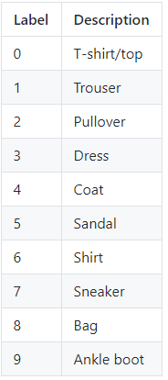
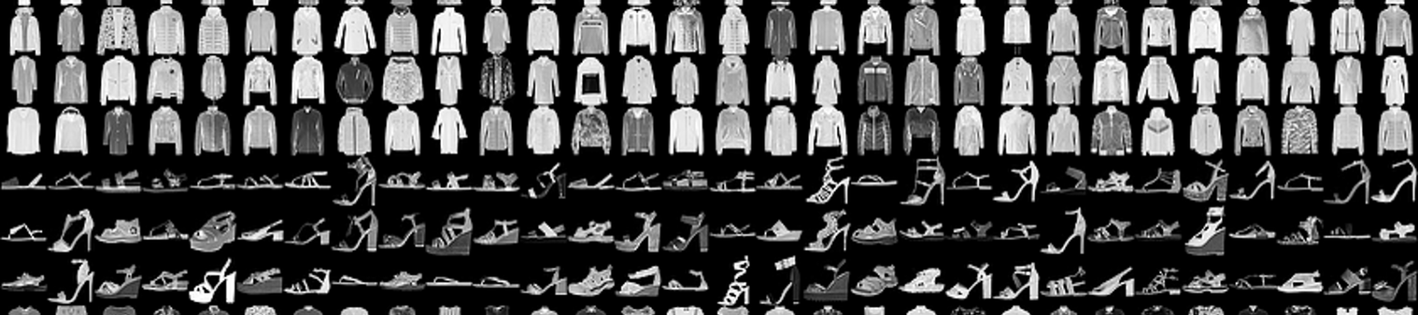
Fashion MNIST
MNIST – Not enough
MNIST is too easy – Simple neural net achieves 98%
MNIST can not represent modern tasks
Fashion MNIST
More challengeable than normal MNIST

Slide 42
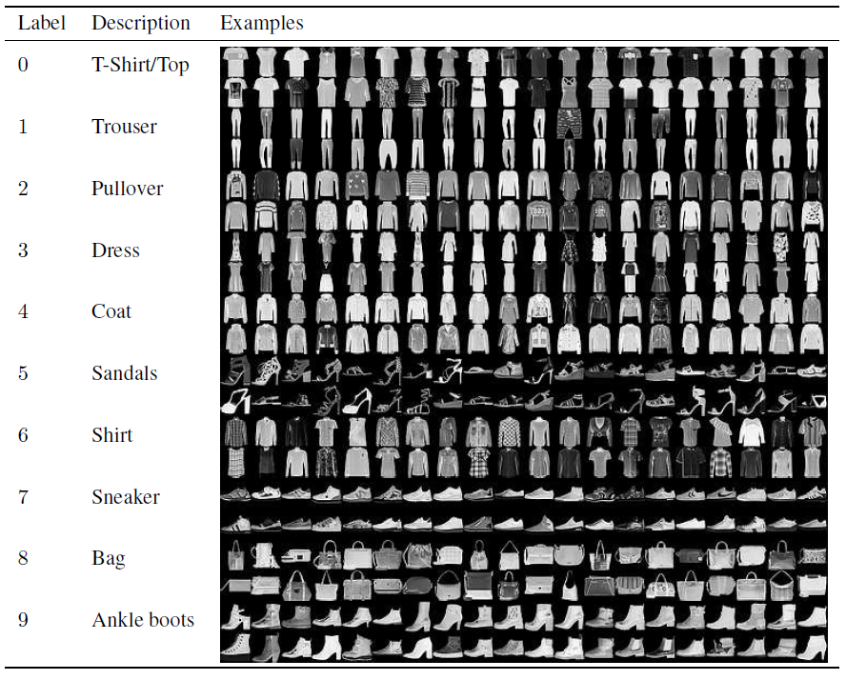
Fashion MNIST
Load Fashion MNIST
Download fashion MNIST on project folder
# mnist = input_data.read_data_sets("./mnist/data/", one_hot=True)
mnist = input_data.read_data_sets('./fashion_mnist/data', one_hot=True)

Slide 43
Practice More
Test your own model
(http://fashion-mnist.s3-website.eu-central-1.amazonaws.com/)
Model | hidden layer: 100 Activation: ReLU | hidden layer: 10 Activation: ReLU | Hidden layer: 10, 10 Activation: tanh
Acc. | 0.877 | 0.850 | 0.840
Model | Hidden Layer? Activation? Regularization (dropout / BN)?
Acc.

Slide 44
DropConnect
DropConnect
Generalization of Dropout
Removing weights with prob. p on only training time
Dropout
DropConnect

Slide 45
DropConnect
Modify the model structure
...
W1 = tf.Variable(tf.random_normal([784, 1024], stddev=0.01))
W1 = tf.nn.dropout(W1, keep_prob) * keep_prob
B1 = tf.Variable(tf.random_normal(shape=[1024], stddev=0.01)) L1 = tf.matmul(X, W1) + B1 L1 = tf.nn.relu(L1) ...

Slide 46
DropConnect
Model | 3-layer | 5-layer | 5-layer ReLU | 5-layer Dropout
Acc. | 0.9784 | 0.9805 | 0.9827 | 0.9826
Run!
Epoch: 0001 Avg. cost = 0.602 Train Acc. = 0.9279636
Epoch: 0002 Avg. cost = 0.212 Train Acc. = 0.9515273
Epoch: 0003 Avg. cost = 0.143 Train Acc. = 0.96514547
Epoch: 0004 Avg. cost = 0.112 Train Acc. = 0.9799455
Epoch: 0005 Avg. cost = 0.091 Train Acc. = 0.98114544
Epoch: 0006 Avg. cost = 0.082 Train Acc. = 0.98663634
Epoch: 0007 Avg. cost = 0.070 Train Acc. = 0.9878727
Epoch: 0008 Avg. cost = 0.064 Train Acc. = 0.9897636
Epoch: 0009 Avg. cost = 0.058 Train Acc. = 0.9916546
Epoch: 0010 Avg. cost = 0.053 Train Acc. = 0.98983634
Epoch: 0011 Avg. cost = 0.049 Train Acc. = 0.99114543
Epoch: 0012 Avg. cost = 0.046 Train Acc. = 0.99349093
Epoch: 0013 Avg. cost = 0.044 Train Acc. = 0.99485457
Epoch: 0014 Avg. cost = 0.043 Train Acc. = 0.99465454
Epoch: 0015 Avg. cost = 0.040 Train Acc. = 0.9957273
Training Done!
Test Acc. = 0.9836

